Slide 1
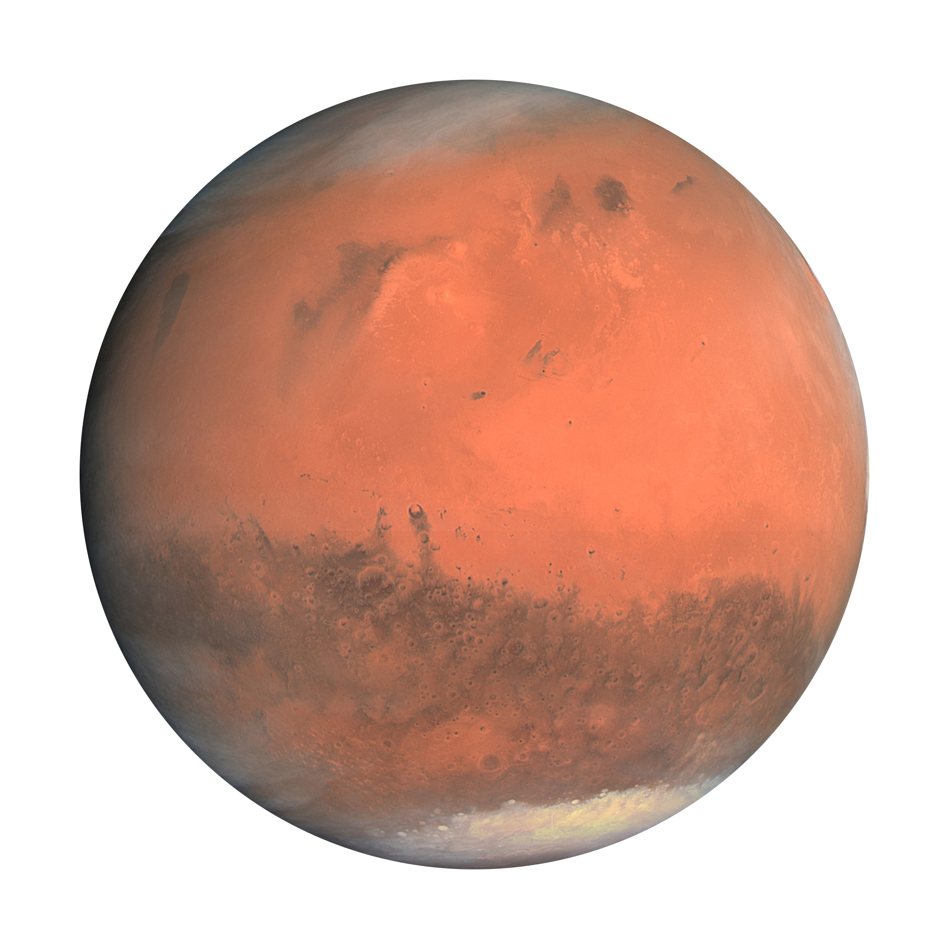




Mapping and characterization of subsurface deposits in Planum Boreum, Mars, using radar sounding
Maia Willis-Reddick
Mentor: Dr. Stefano Nerozzi
Saturday, April 24th
The Hilton Tucson East
University of Arizona Lunar and Planetary Laboratory
OSIRIS (ESA)

Slide 2
Planum Boreum
CTX (JPL/NASA)

Slide 3
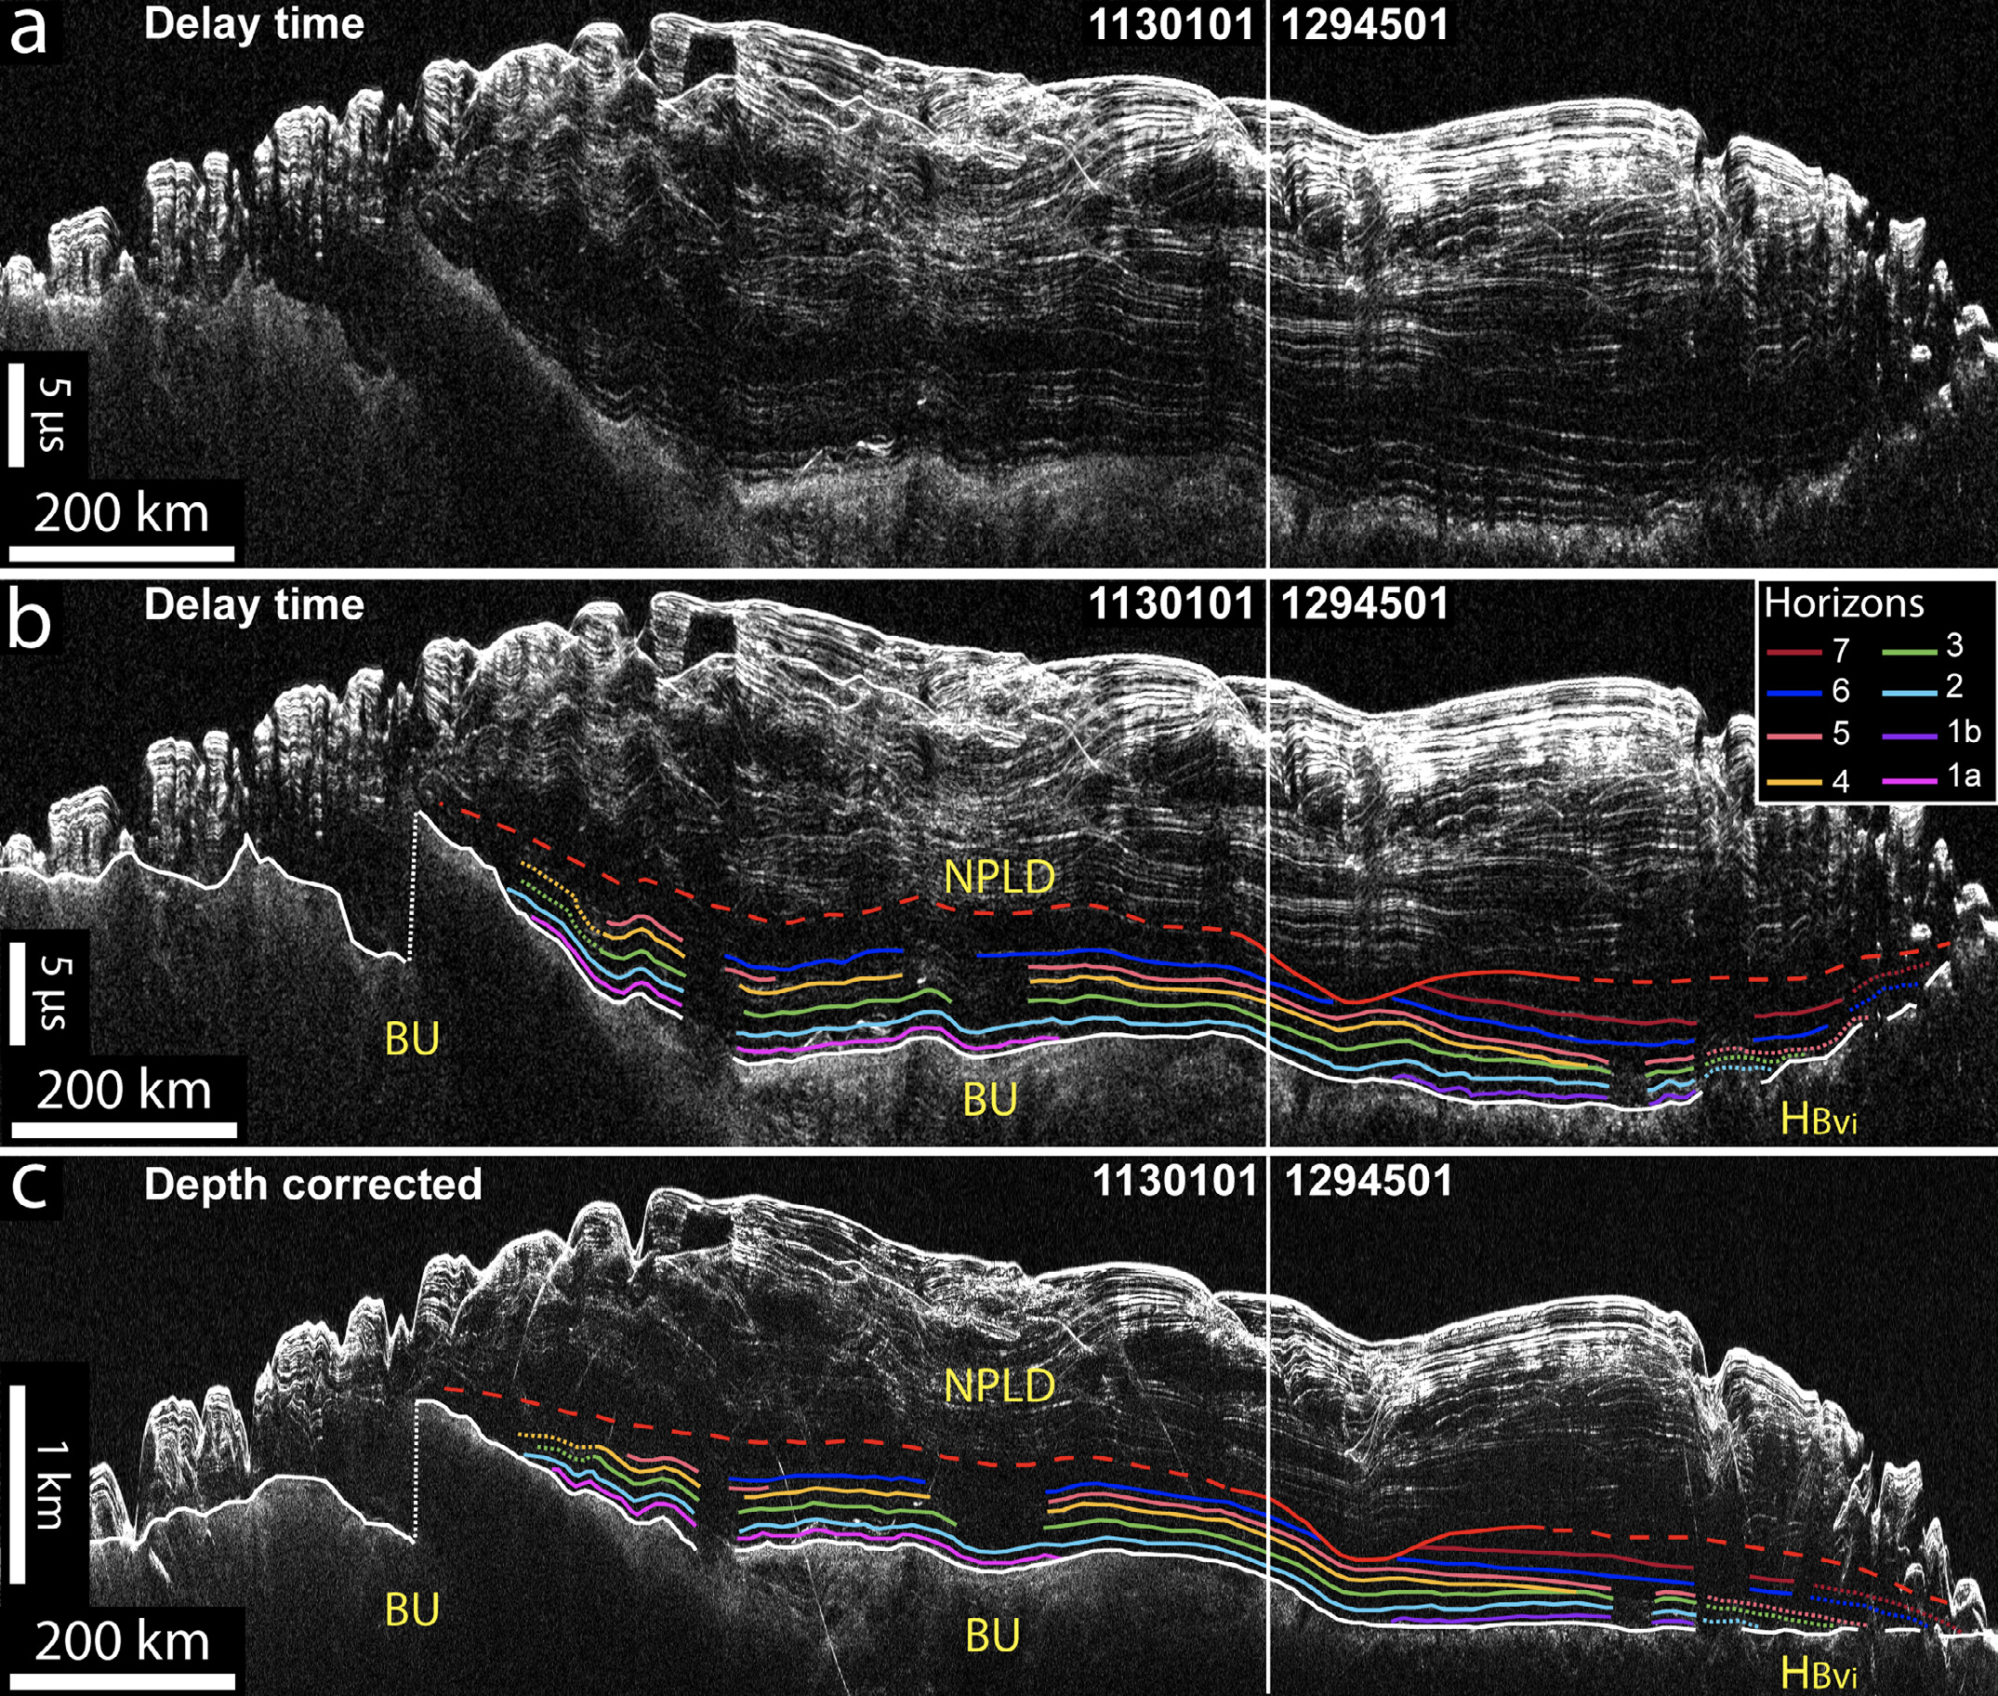
Internal layering structure provides insight into climate history and evolution of North Polar Layered Deposits within the North Pole
Nerozzi and Holt (2018)

Slide 4
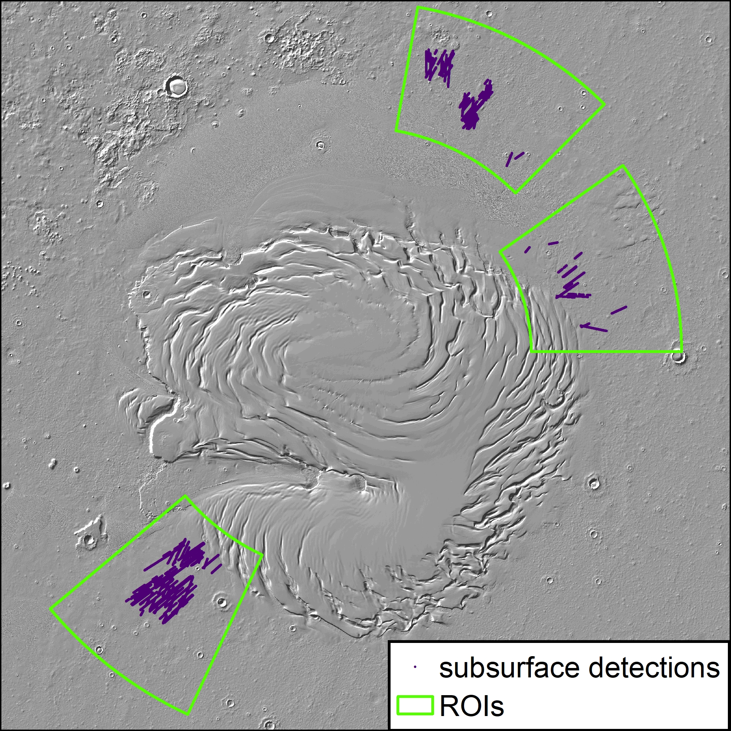
Why here?
NPLD
Main ROI

Slide 5
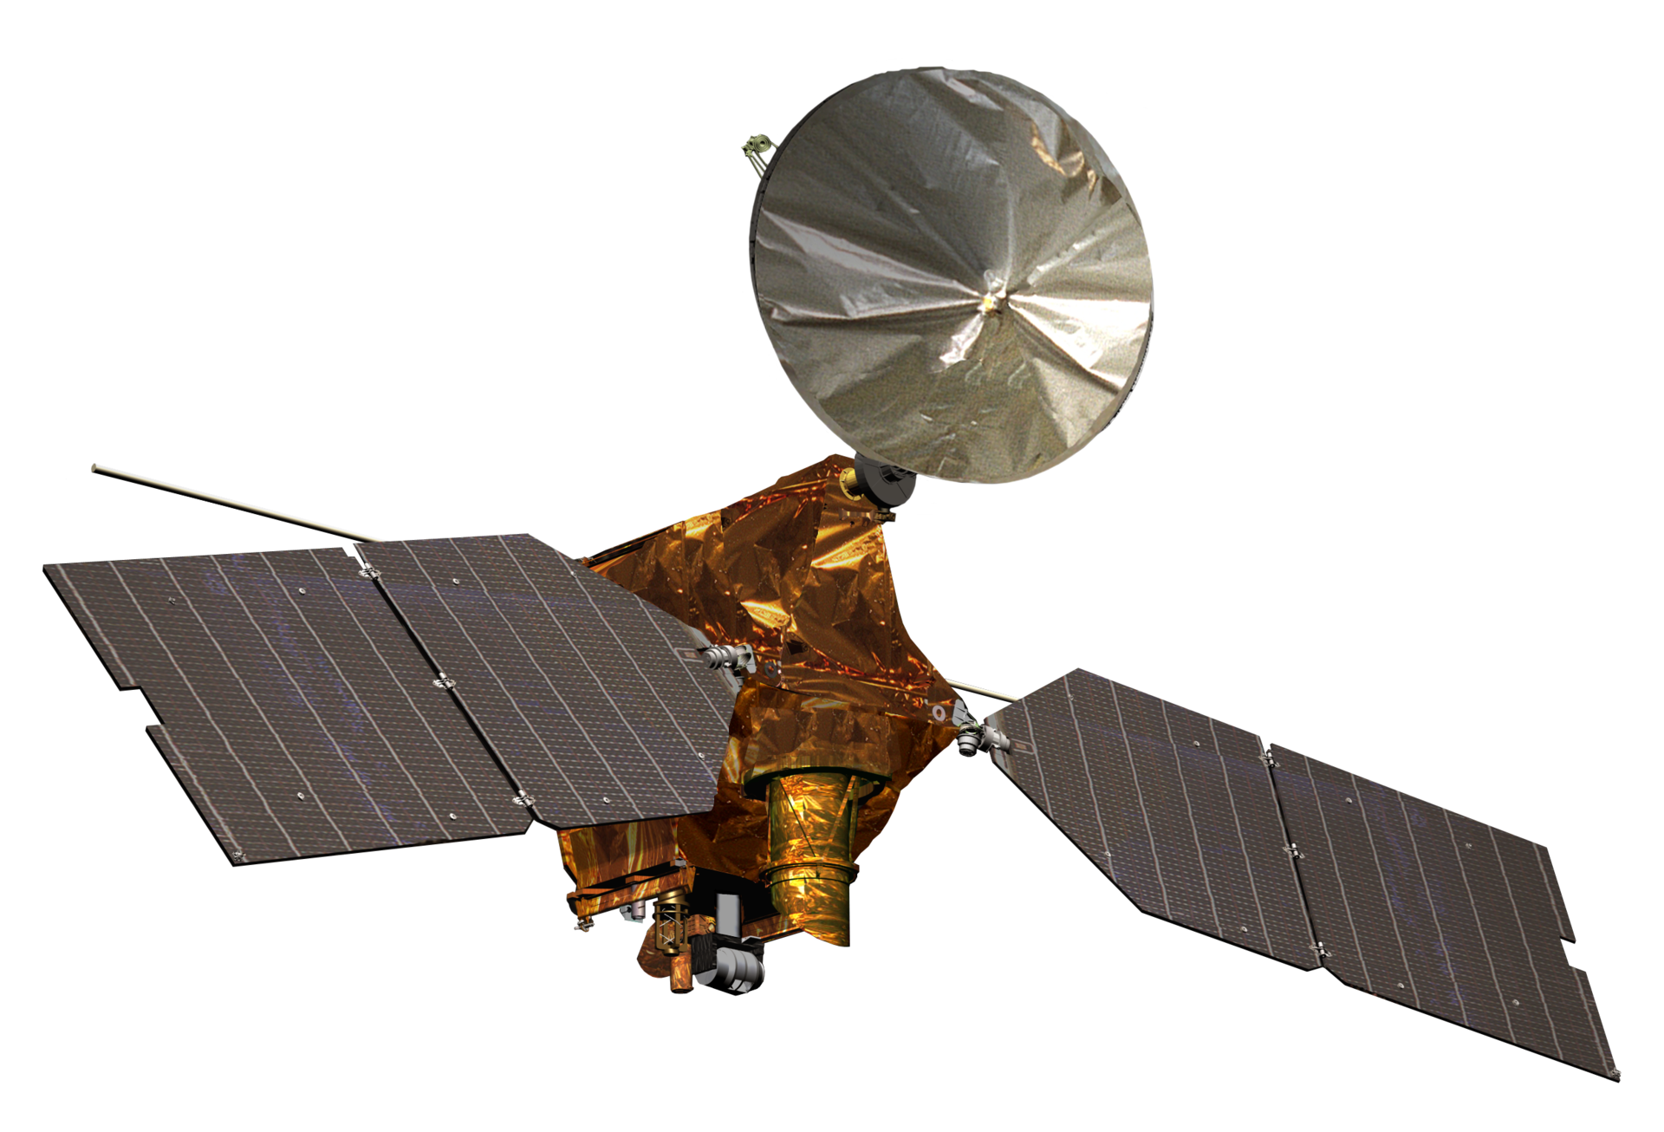
SHARAD
SHAllow RADar
Operated through Italian Space Agency
15-25 MHz frequency
Onboard the Mars Reconnaissance Orbiter
MRO. (NASA)
Notes:
Do a radar animation

Slide 6
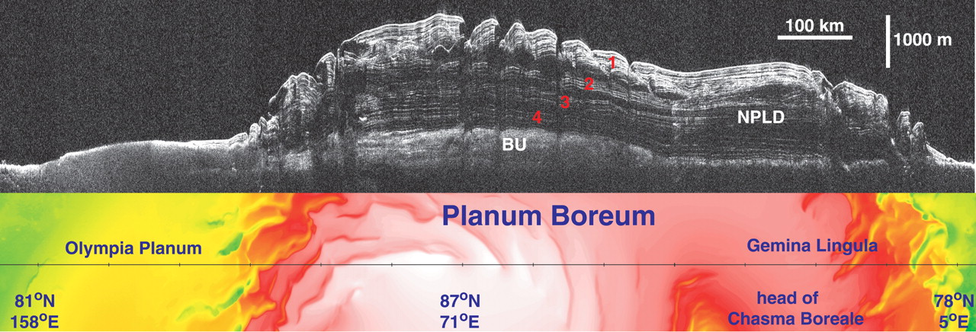
Radar sounding with SHARAD
Philips et al. (2008) SHARAD orbit 5192 radargram

Slide 7
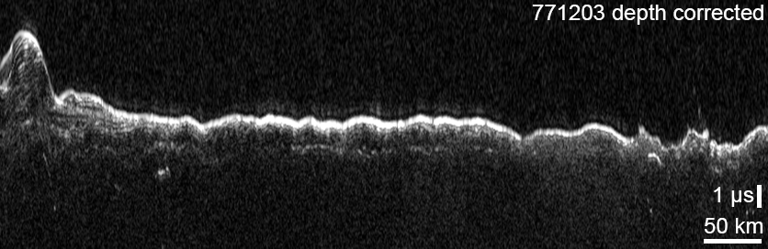
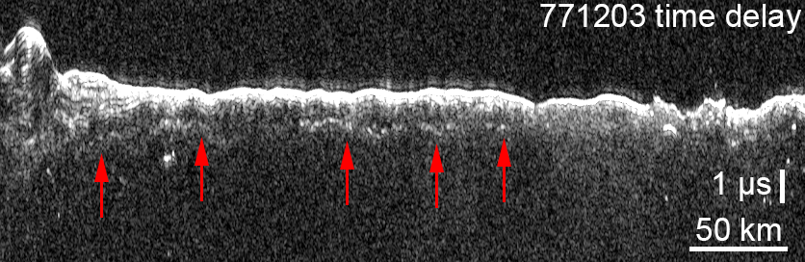
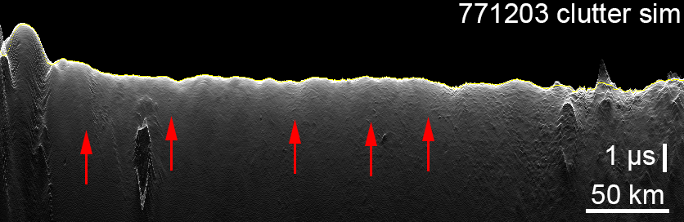
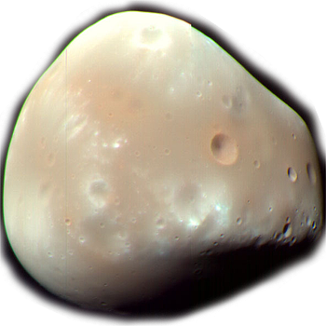
Method
We used Seisware Geology
In-house clutter simulations used to cross-check detections for subsurface vs. surface detections
  Clutter simulations used to delineate between surface and subsurface features
Notes:
Elaborate on clutter sims

Slide 8

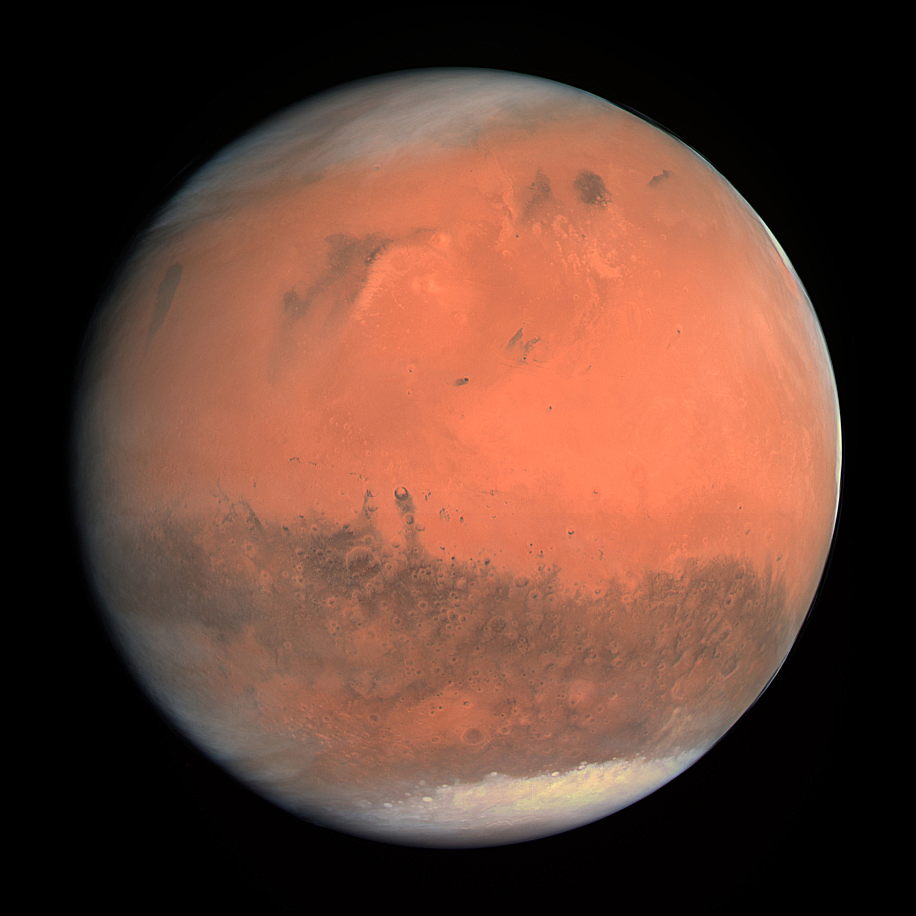
Dielectric permittivity and loss tangent
Dielectric permittivity: the ability of a material to hold and transmit an electric charge
Complex number: the real part determines the velocity of radio waves in a medium, the imaginary part is associated with loss
ε = ε’ - iε’’
The loss tangent is the ratio of imaginary vs real part
tan δ = $\frac{ε^{′′}}{ε^{′}}$

Slide 9
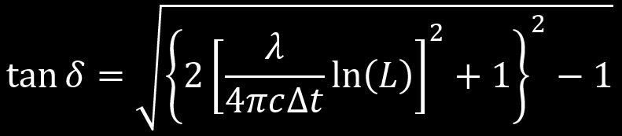
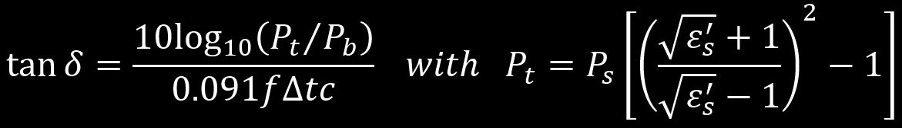
Campbell (2008)
Grima (2009)

Slide 10
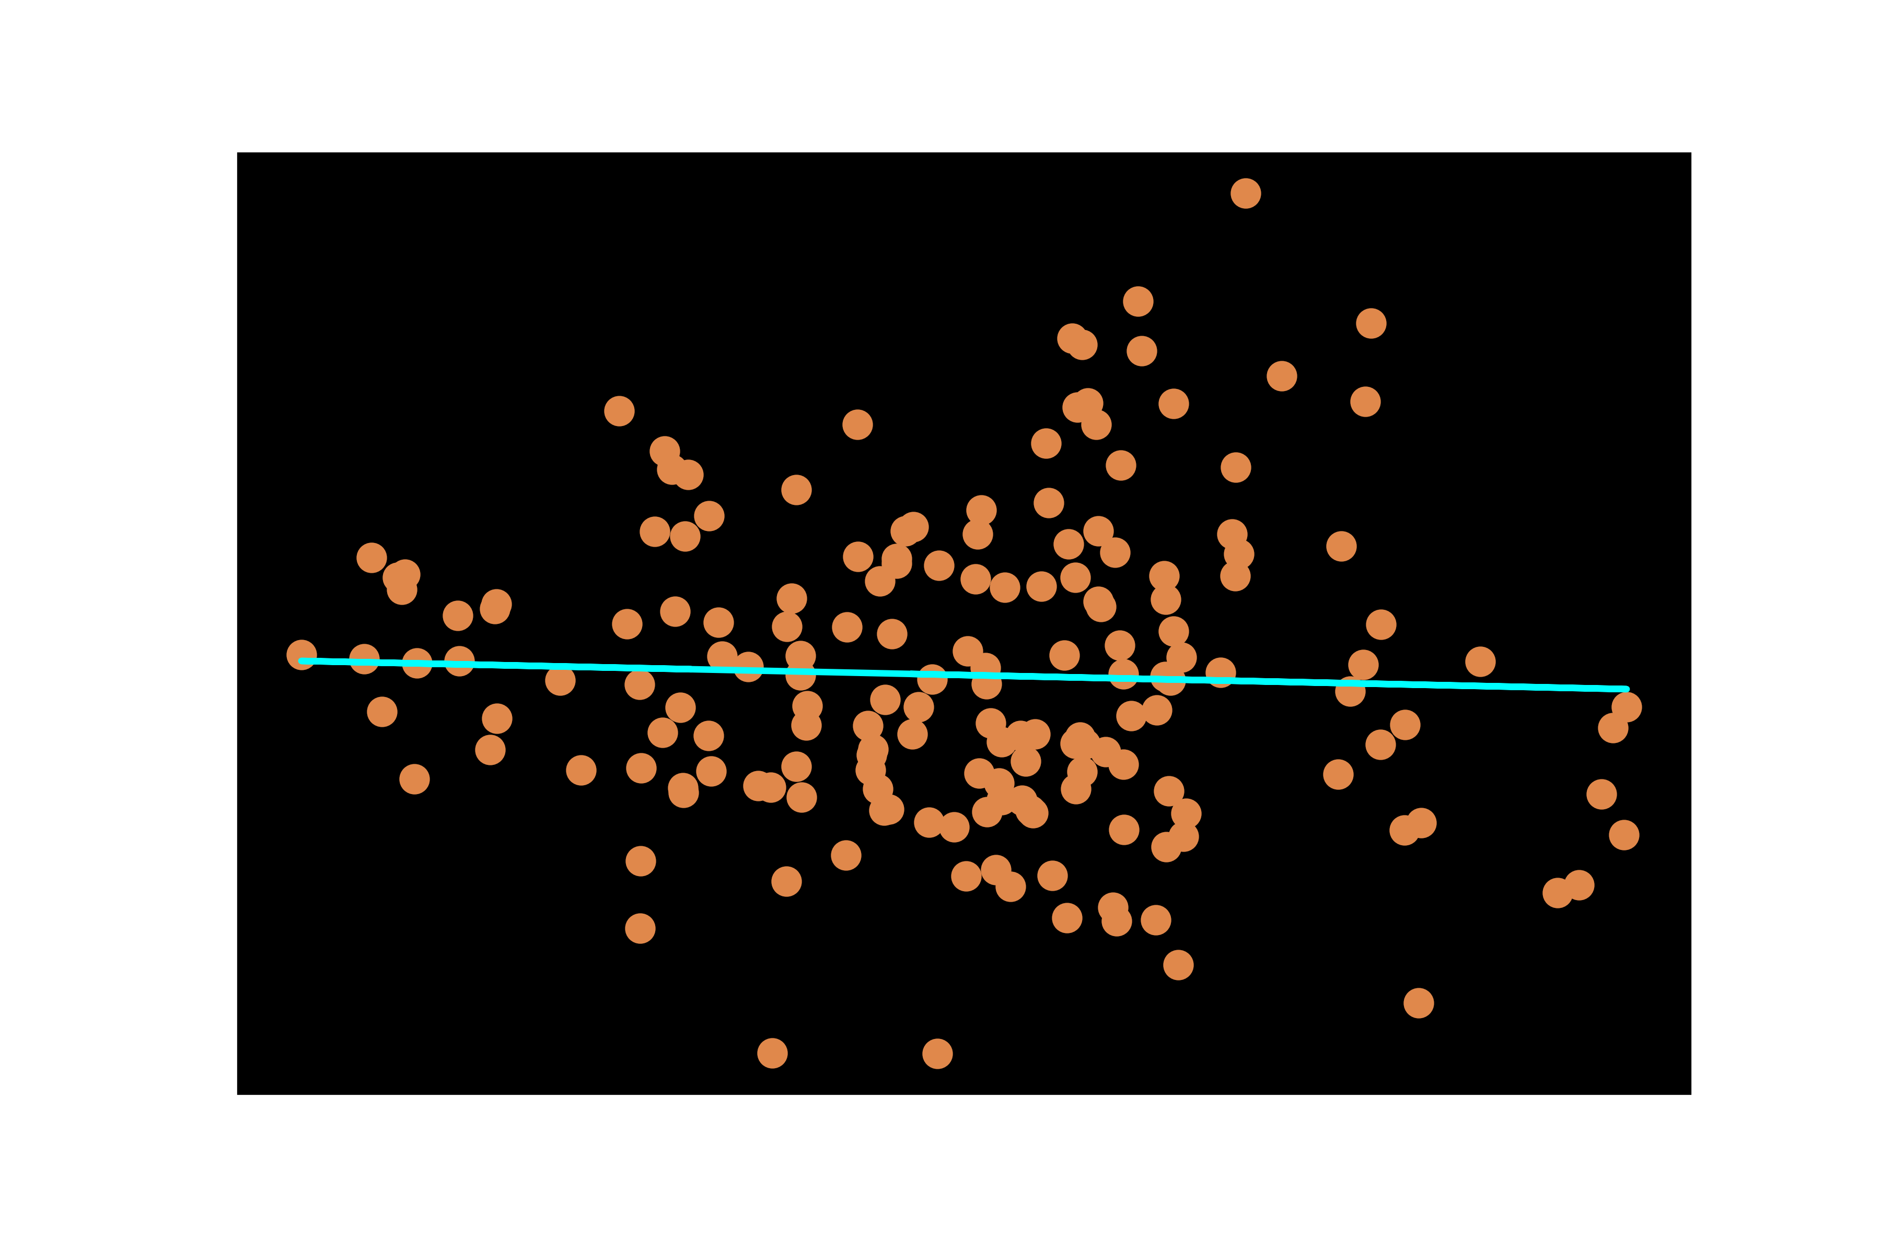
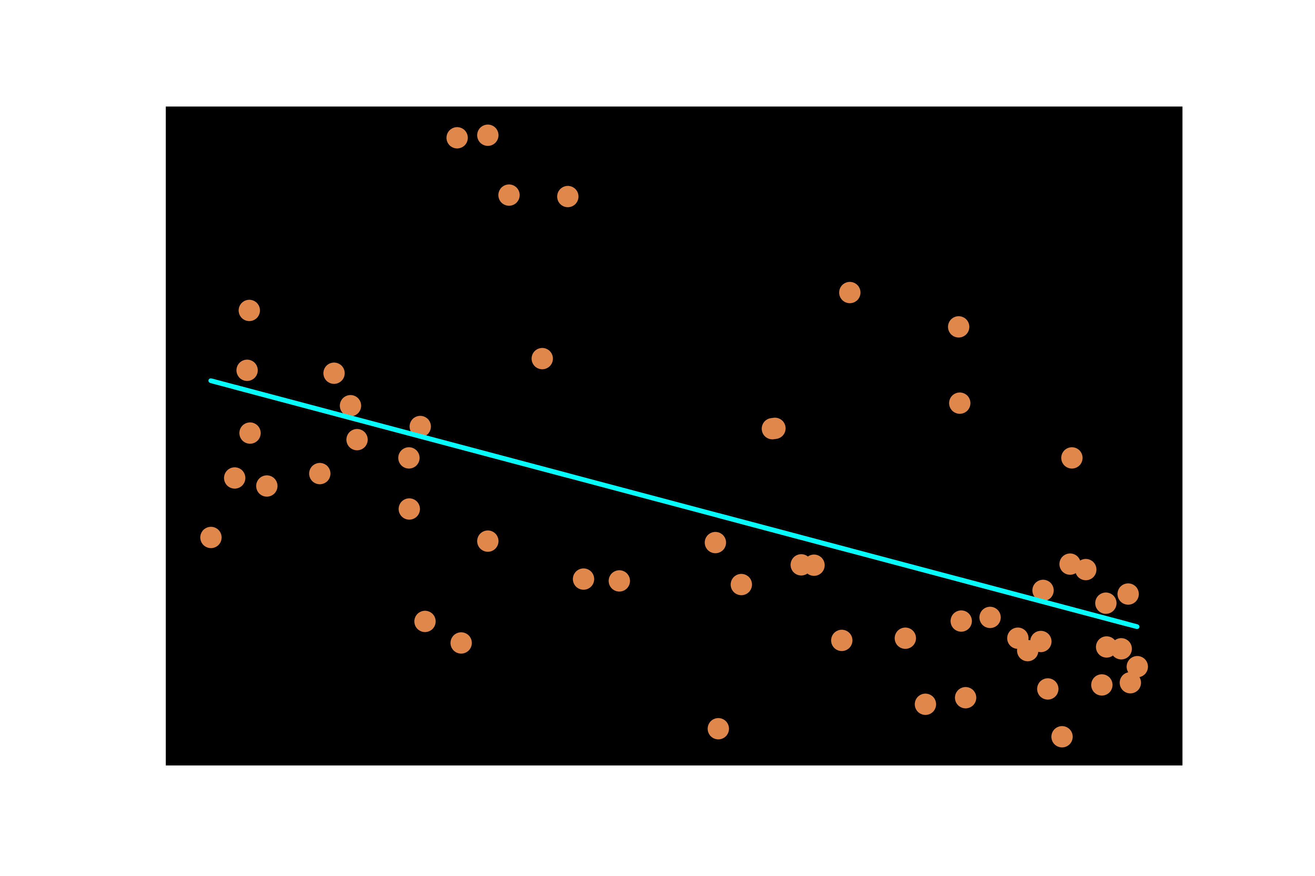
Results
Mean ($μ=0.012$) indicative of water ice composition with lithic inclusions

Slide 11
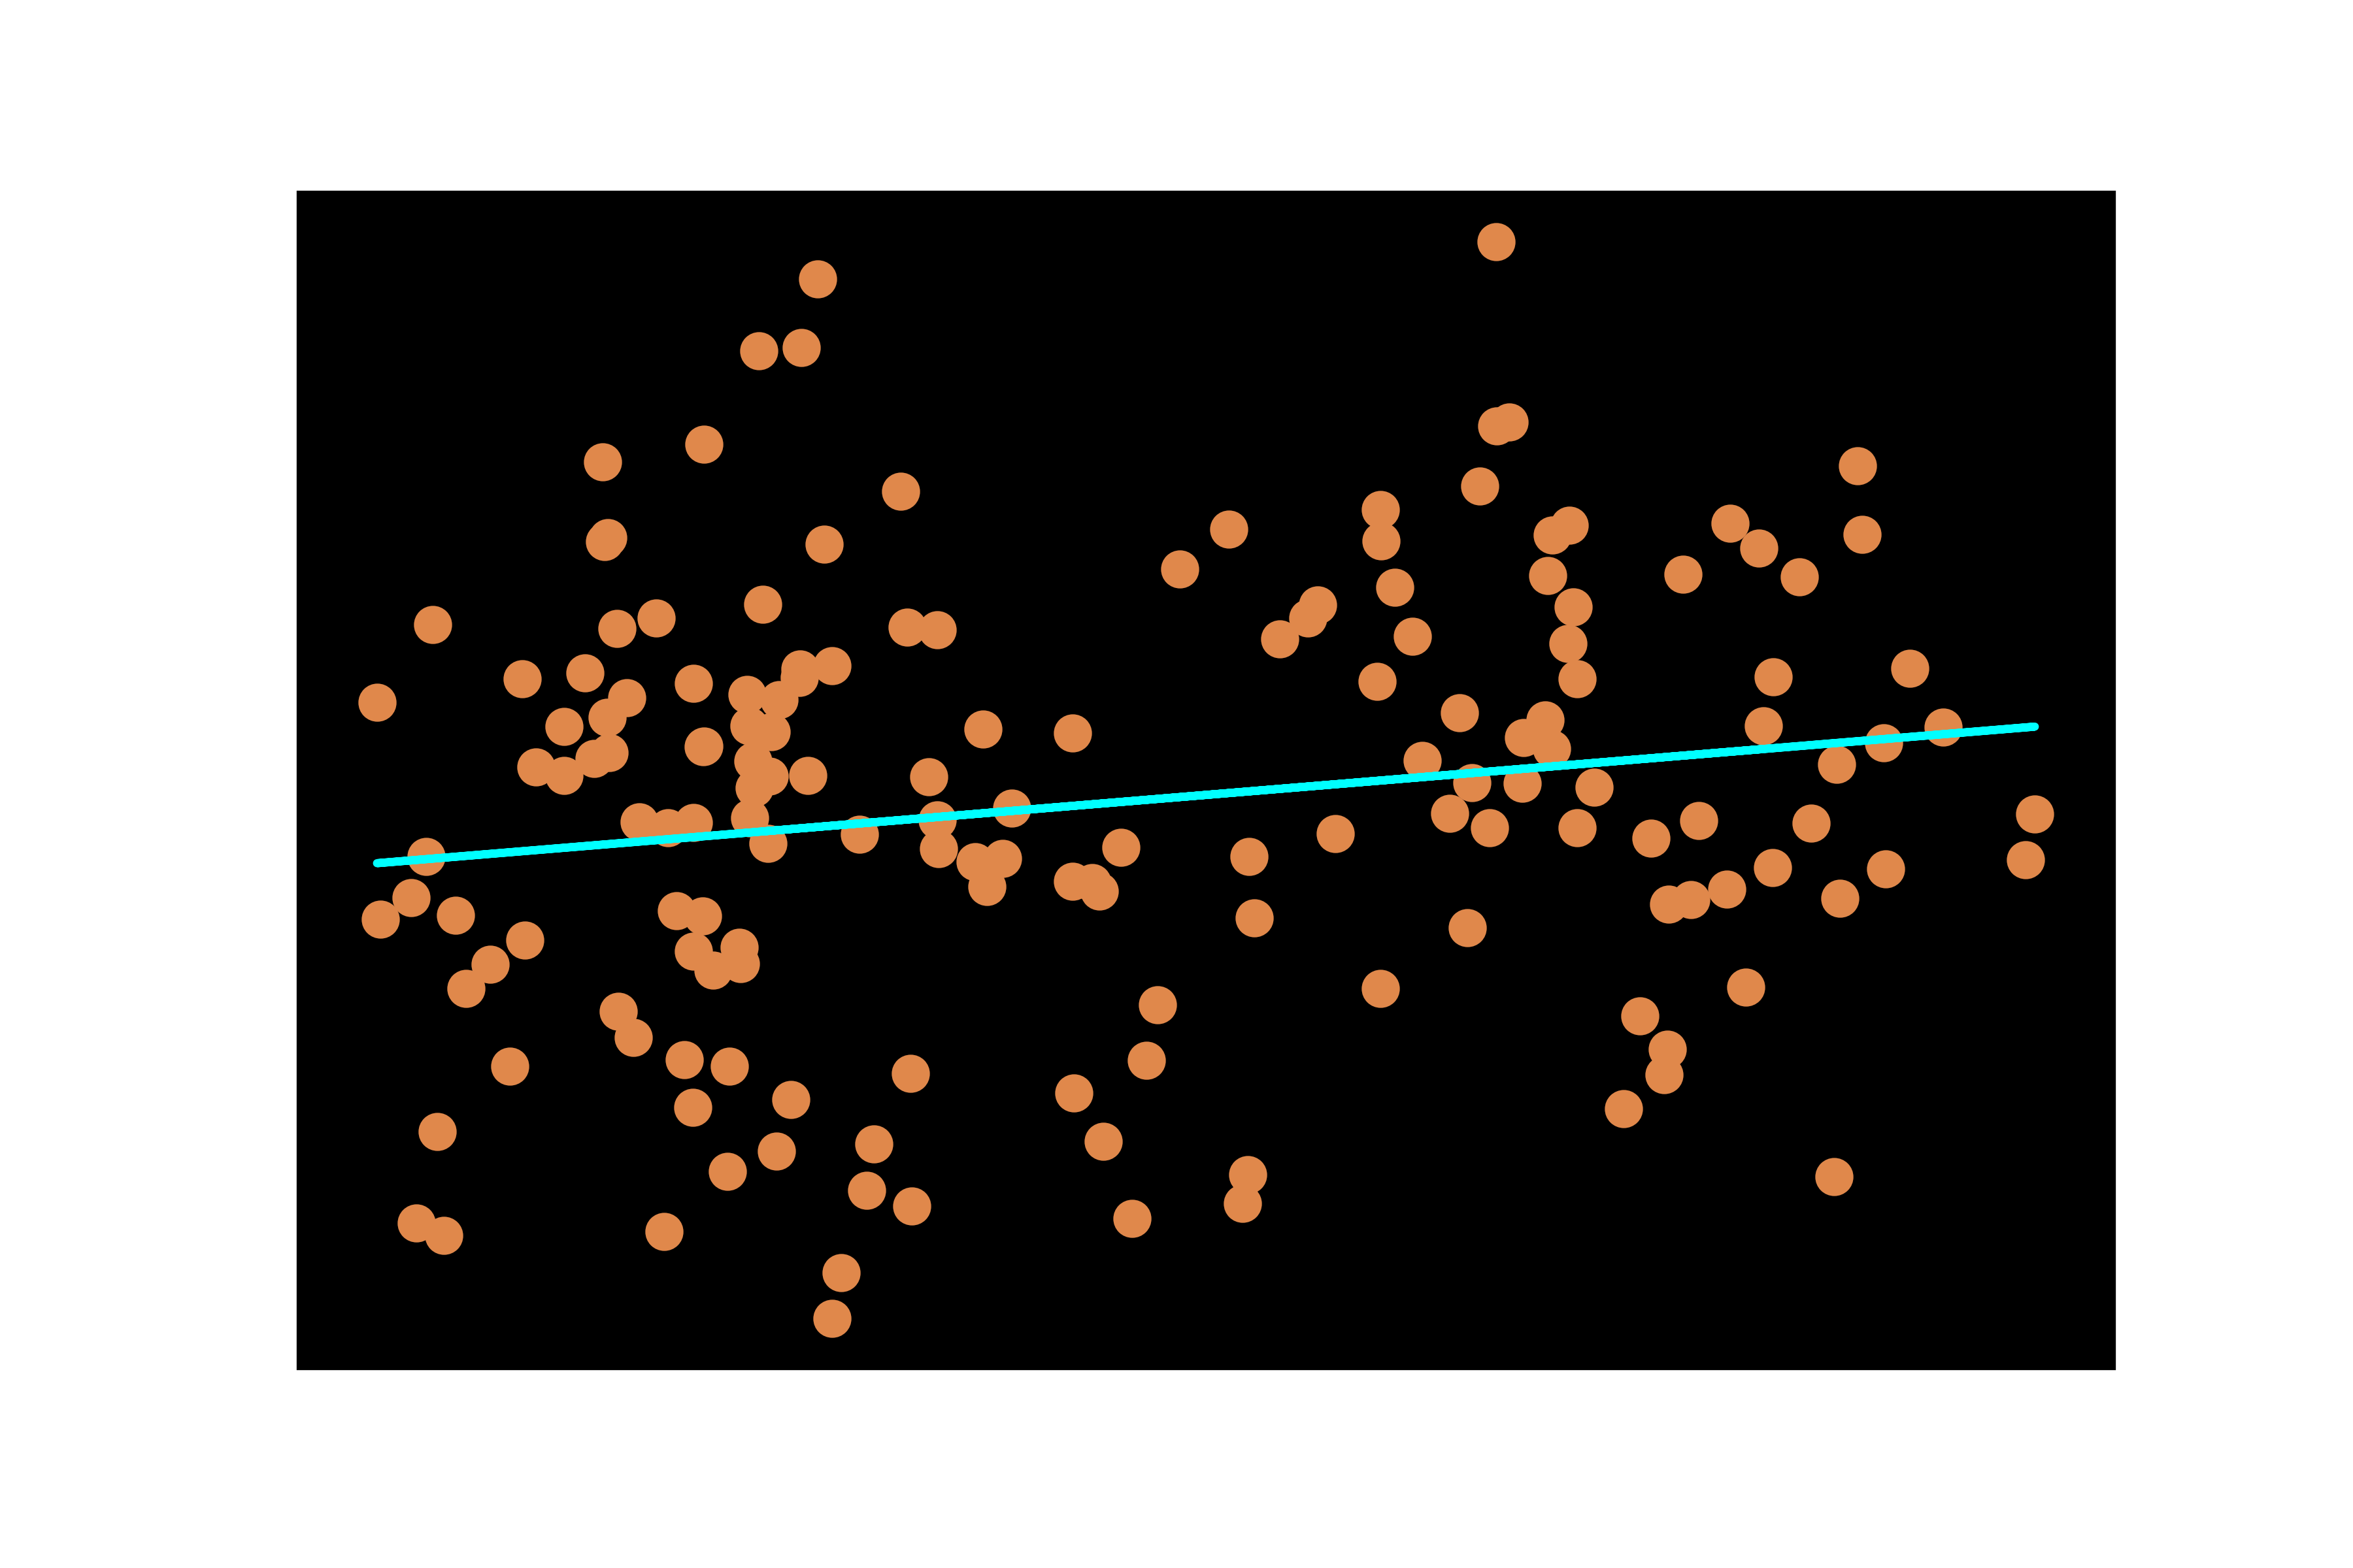
Not a strong correlation—could indicate changes in composition or dynamically moving surface

Slide 12
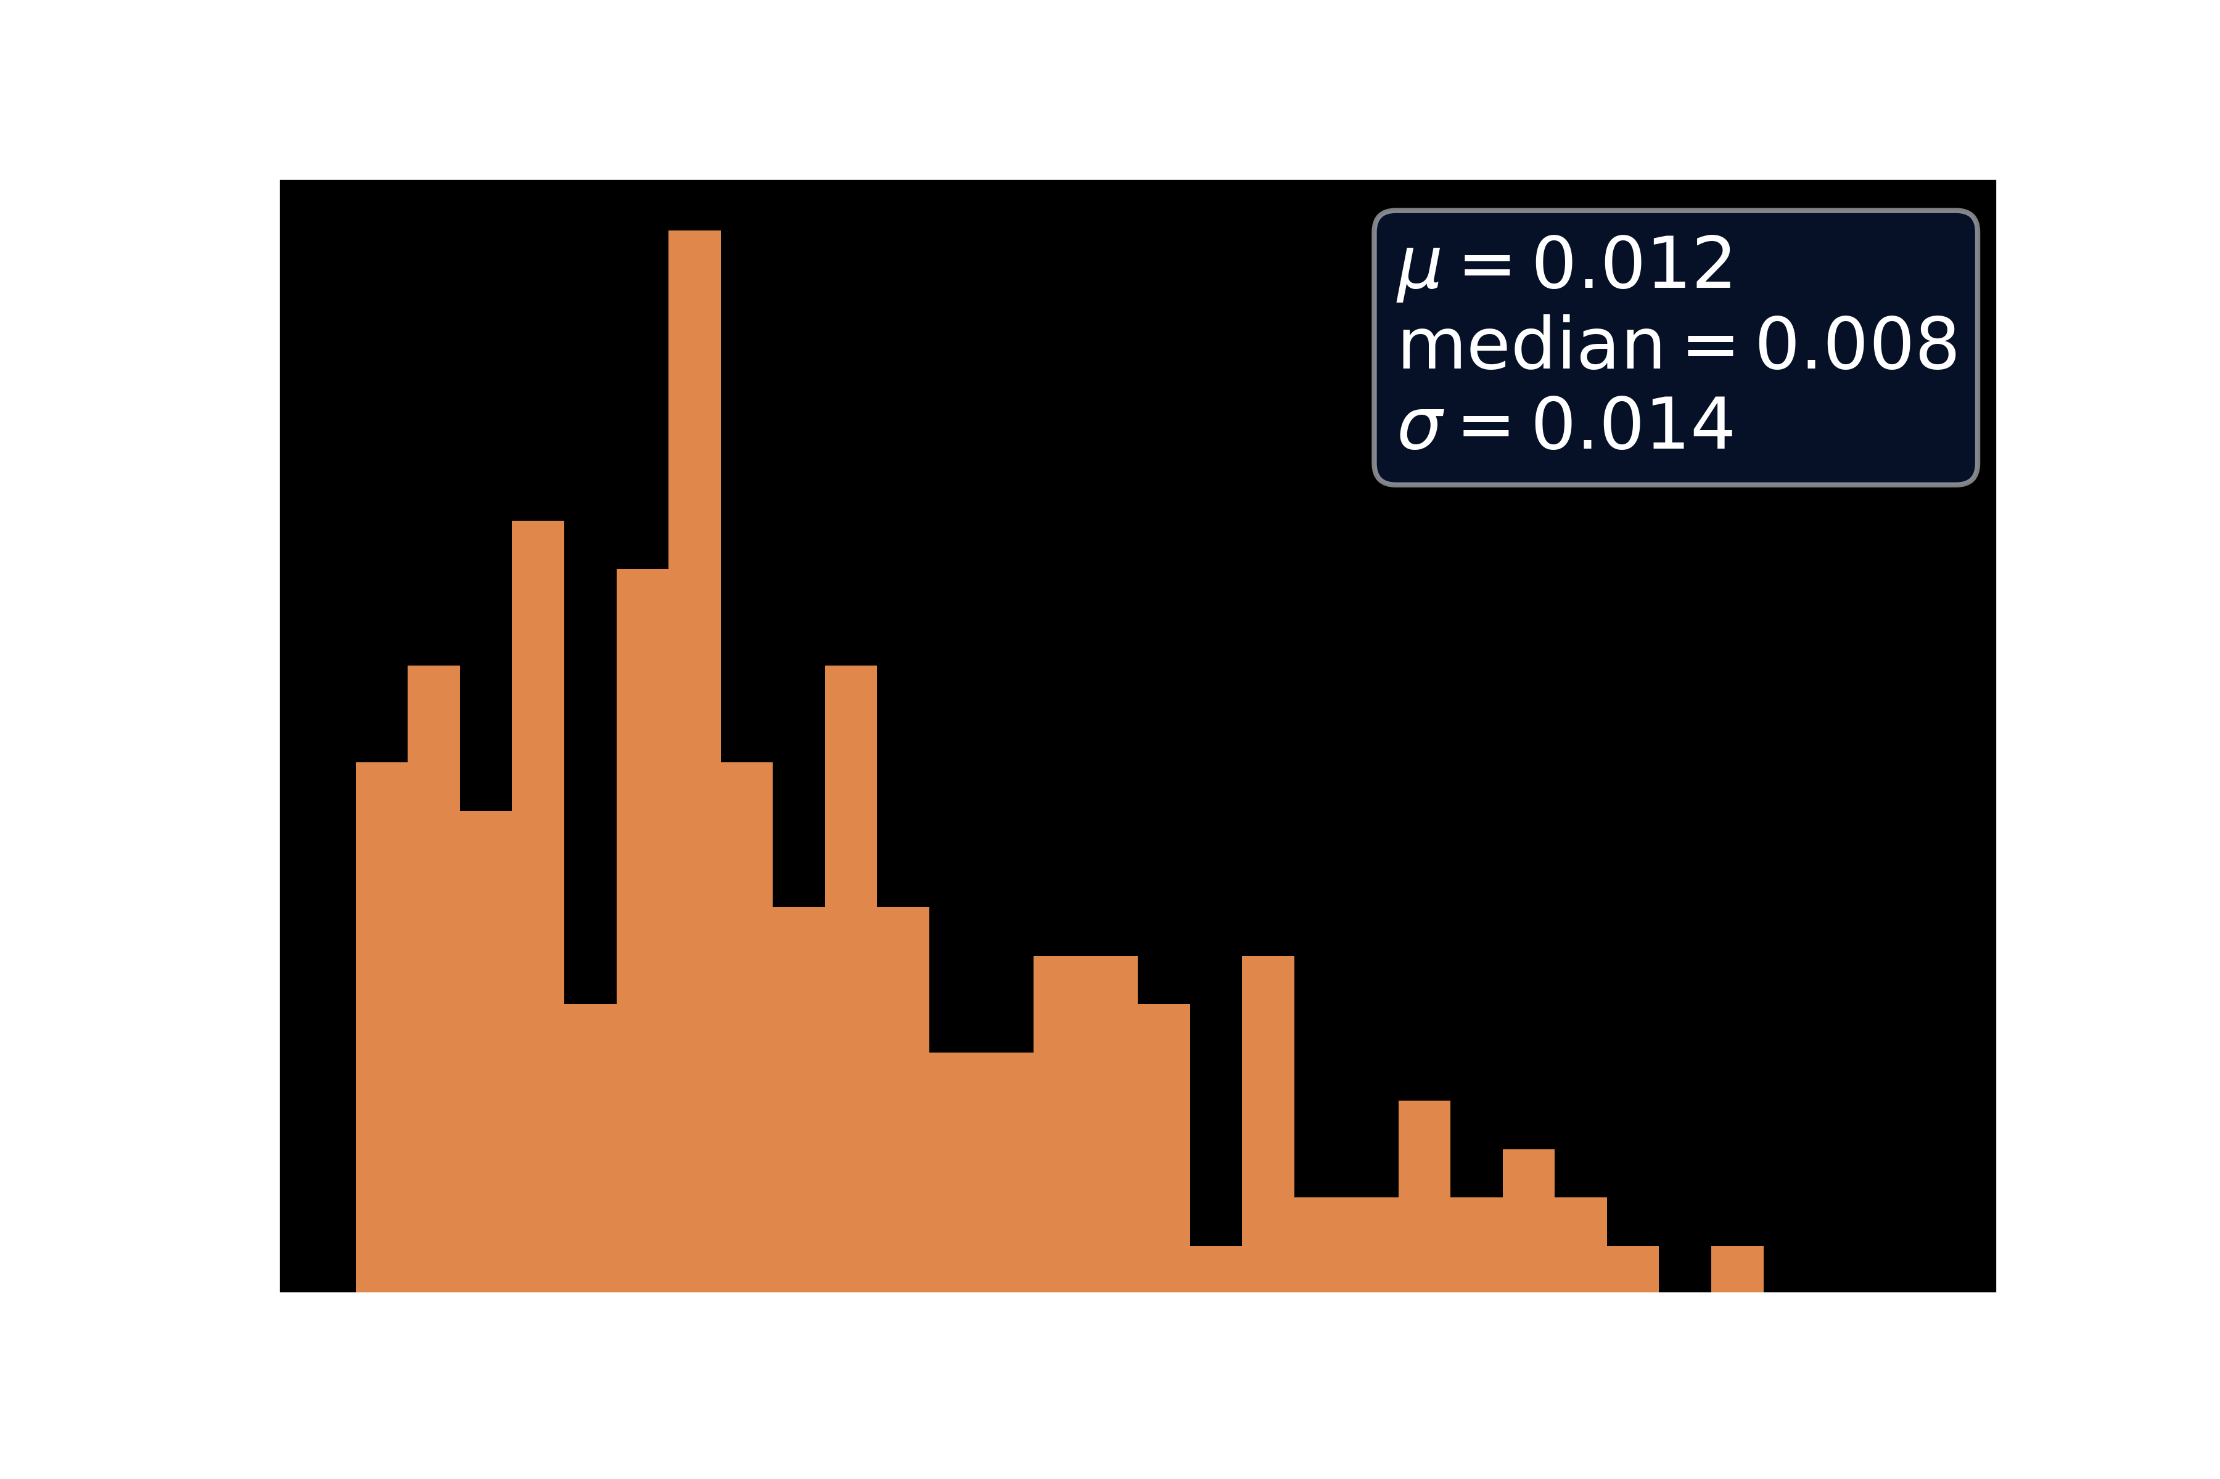

Using Campbell (2008) method:
$μ=0.012$ consistent with $ε^{′}=3.1$—water ice
Median= 0.008—intermediate
Mixture of both?

Slide 13
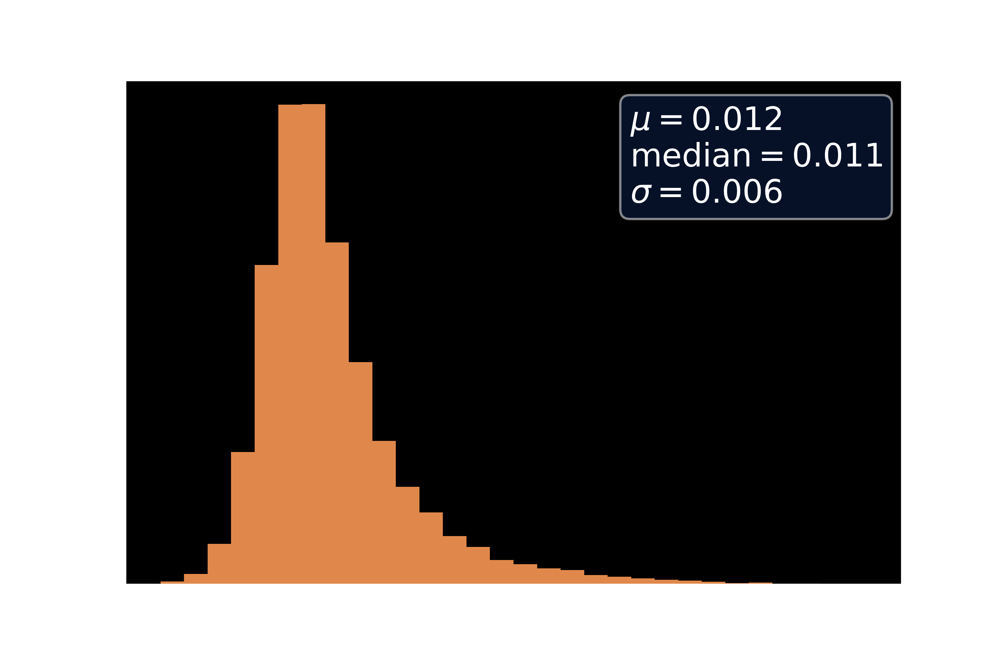
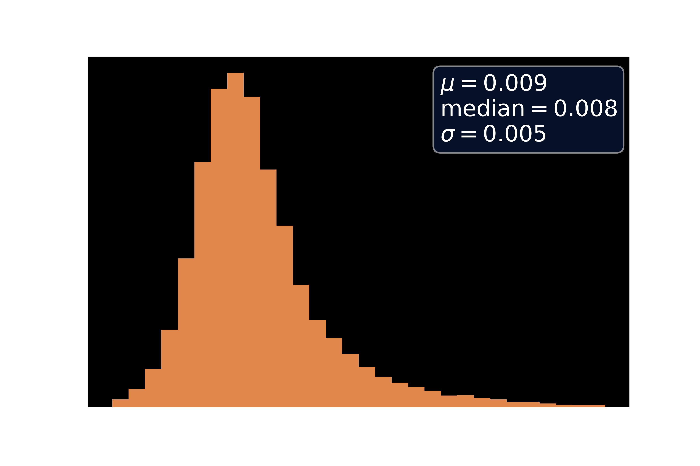
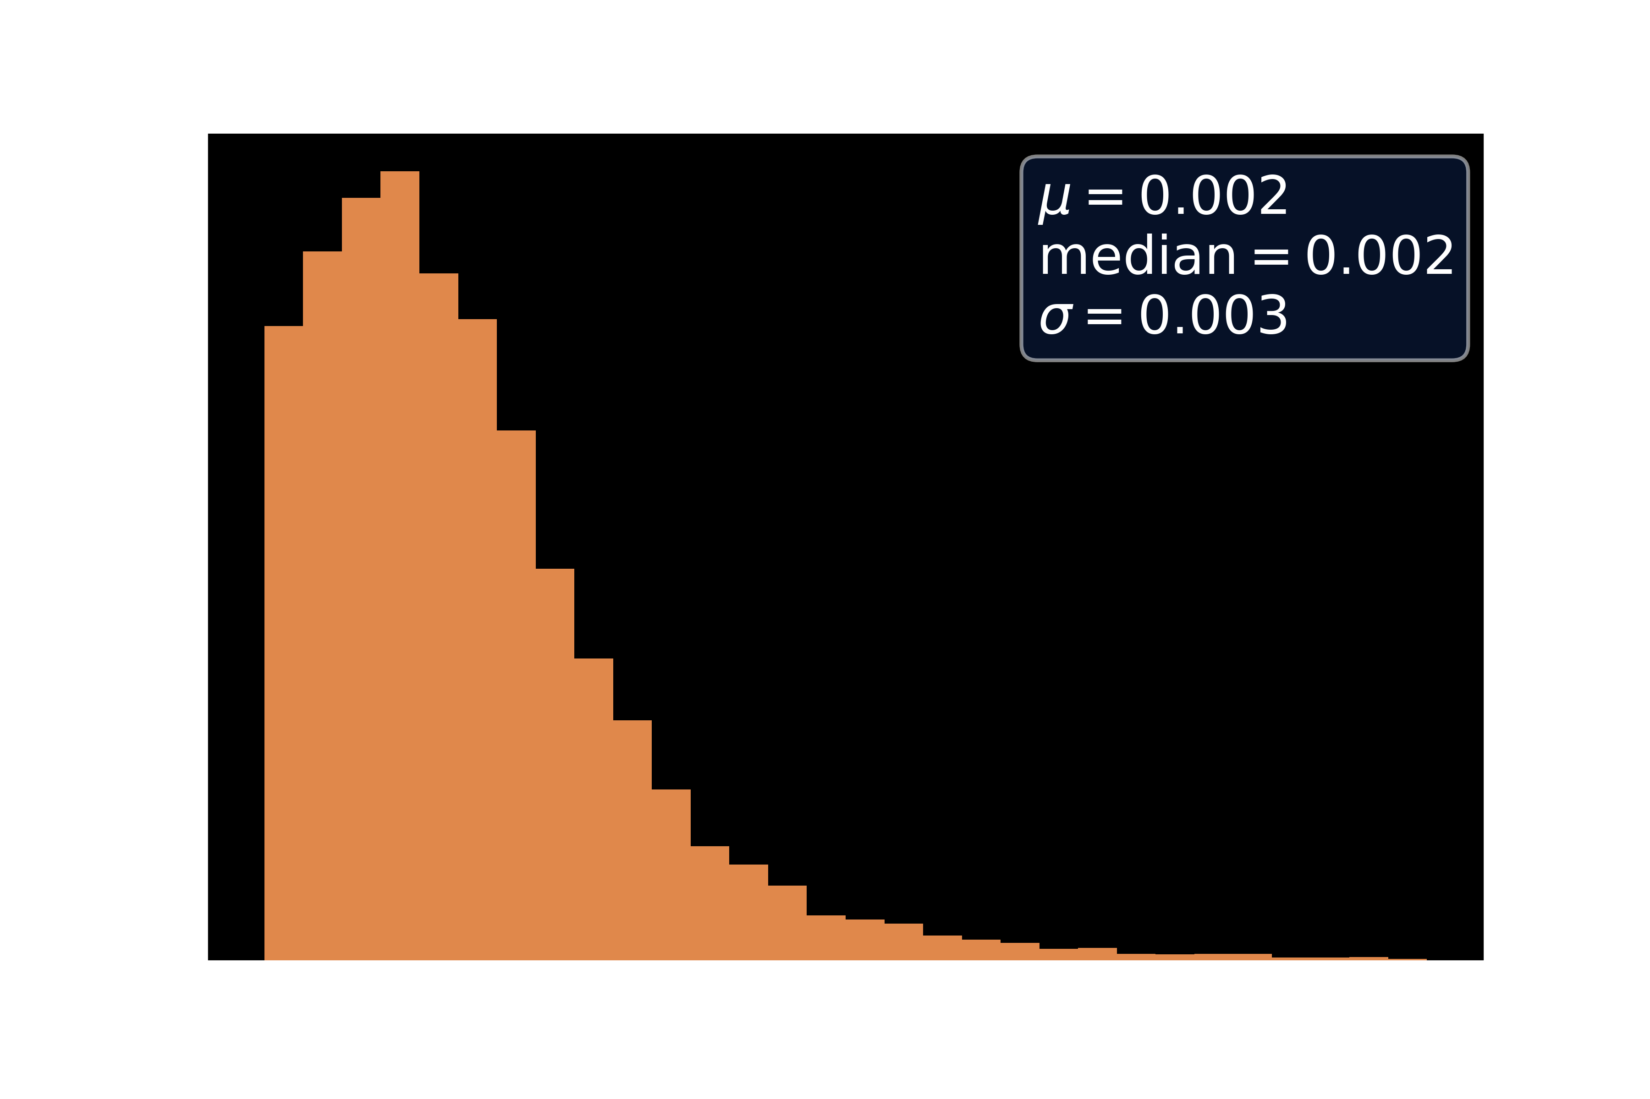

Using Grima (2009) $ε^{′}$ value estimated from lab conditions in main survey area

Slide 14
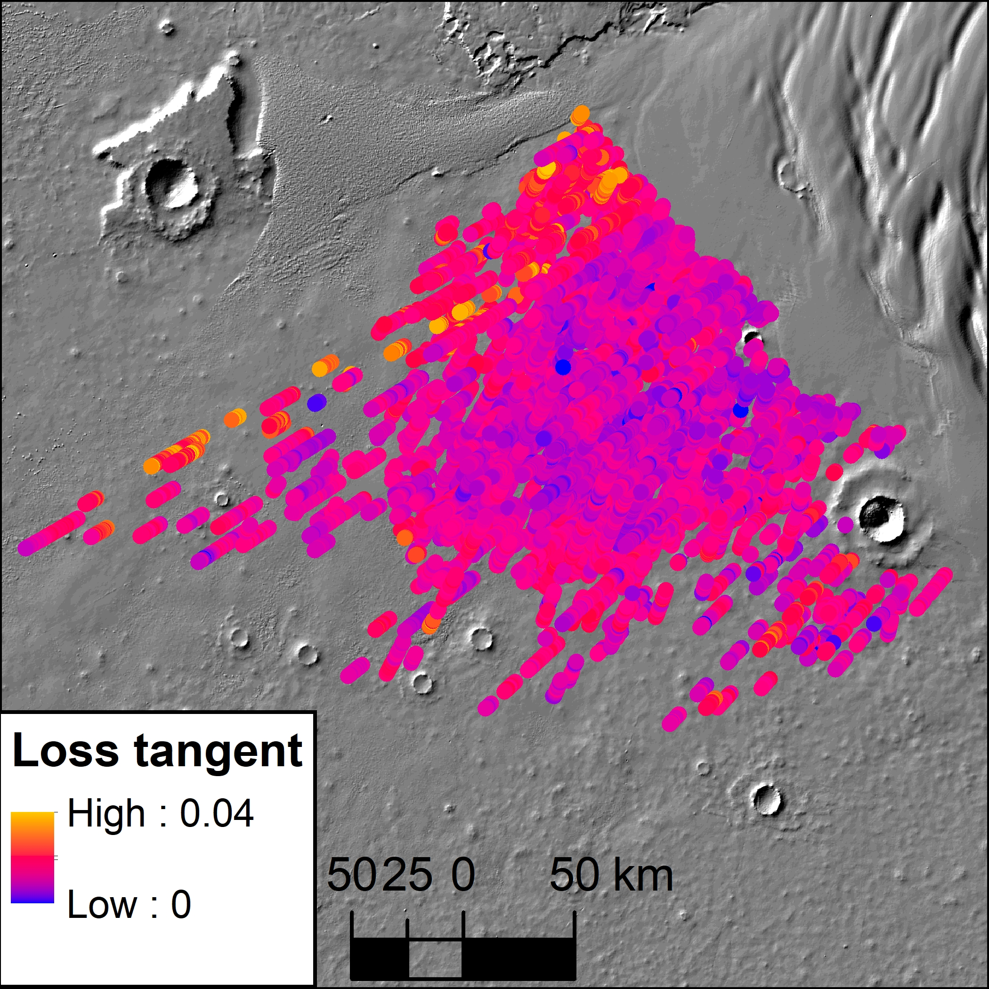
Current map of loss tangents
Investigation of ‘stripe’ of high loss tangent needed

Slide 15
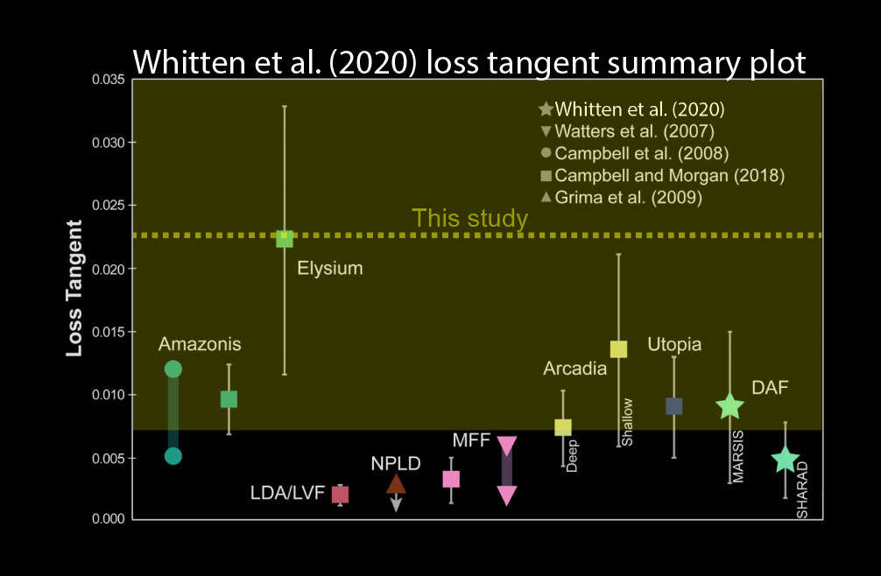

Loss tangent of $ε^{′}=3.1$ near north pole suggests water ice rich mixture with minor fraction of lithic materials (e.g. basalt)
Assuming pure water ice composition, average thickness is ~100m
Positive power loss rate atypical

Slide 16
Future investigations
Extend mapping to remaining regions of interest
Surface roughness and thermal modeling to be conducted
Further analyses of loss tangent distributions necessary
Remaining ROIs
Mapped
HiRISE/University of Arizona
Notes:
Put in GRS possibility also

Slide 17
Acknowledgements
Thank you to the Arizona Space Grant Consortium, NASA, the entire TAPIR group at the University of Arizona’s Lunar and Planetary Laboratory, and especially Dr. Stefano Nerozzi for his mentorship

Slide 18
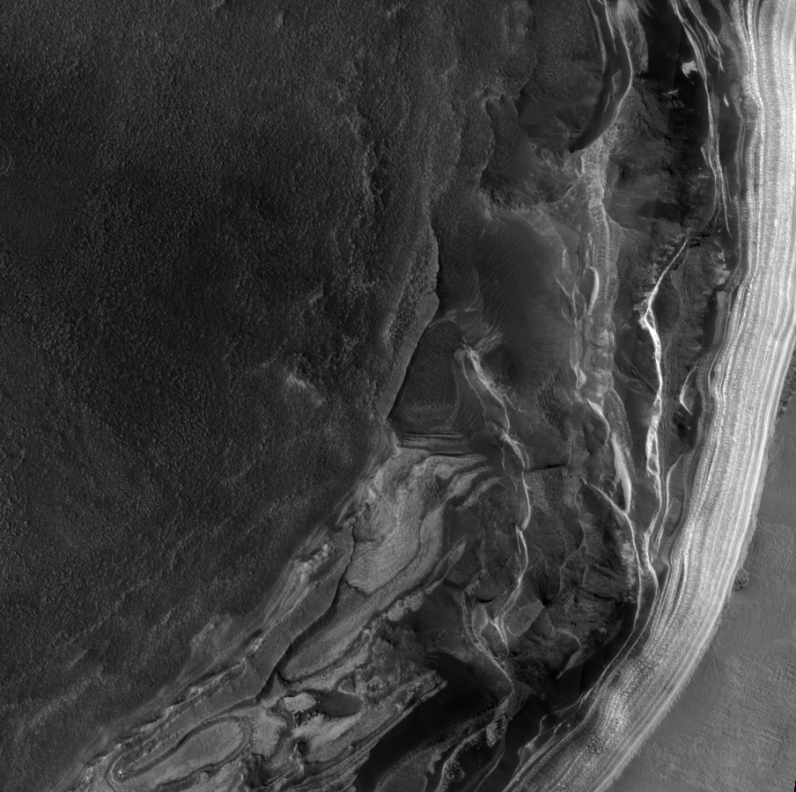
Thank You
HiRISE (University of Arizona)

